Slide 1
Predicting Housing Prices in Ames, Iowa
Foundations of Data Science Capstone Project
May 2018
Blake Cizek

Slide 2
Project Overview
Goals:
Practice data wrangling, exploratory data analysis, statistics and machine learning skills
Predict housing prices in Ames, Iowa - based on Kaggle’s Advanced Regression Techniques Competition
The recipient of this project would ideally be Zillow, a technology leader in the real estate industry.

Slide 3

Project Results
Following the outlined method on the Kaggle’s data sets, Lasso Regression and XGBoost models were used to predict the housing prices in the provided test set:
The Lasso regressions performed best of the two models with a cross validation RMSE of 0.1142. Lasso did not select a substantial number of the available variables in its model. Due to the multicollinearity among most variables, this was expected.
The XGBoost model performed a close 2nd with a cross validation RMSE of 0.1189.
Although Lasso and XGBoost are fundamentally different models, averaging of the predictions performed to improve the test set results.

Slide 4
Project Recommendations
Improve general quality of data entry validation and process. For the most part, values that were missing in this data set were related to the fact that certain homes did not have features such as pools, garages, alleys, basements, etc. The existence of binary markers for whether homes have these features would improve the process by avoiding imputation.
As outlined in the Feature Engineering section of this project, add variables such as ‘TotalBath’, ‘Age’, ‘Remod’, ‘New’, ‘TotalSqFt’, ‘TotalPorchSqFt’, and ‘NeighborhoodWealth’. These variables added significant value to the model both in feature importance as well as general data cleanliness to cut down on the sometimes 8+ variables that made up one feature of a house.
Use Lasso Regression models as the starting block for predicting housing prices as it was able to perform better than XGBoost, using significantly les variables. Averaging the two allows for a good balance, but fine tuning Lasso Regression or models related to it is the preferred method due to better accuracy and model runtime efficiency.

Slide 5
Data & Method
Data:
Kaggle is the primary source used in this project. This data consists of a training set and a test set. Present in each set are 79 predictor variables (house attributes) and one target variable (price).
Each predictor variable could be categorized as:
lot/land variables
location variables
age variables
appearance variables
external features (pools, porches, etc.) variables
room/bathroom variables
kitchen variables
basement variables
roof variables
garage variables
utilities variables
Method:
Brief EDA of Kaggle’s Data Sets
Data Wrangling
Missing Data
Imputing Data
Label encoding/factorizing variables
Detailed EDA of “Tidy Data”
Visualization & Stats work
Feature Engineering
Model Prep
Dropping highly correlated variables
Removing outliers
Data normalization
Data Modeling
Lasso Regression
XGBoost Model
Model Average & Results

Slide 6
EDA of “Untidy Data”

Slide 7
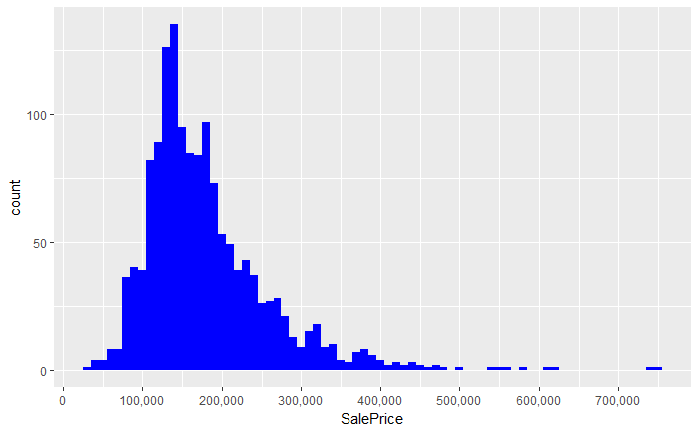
SalePrice - Response Variable
Sale Prices are right skewed, as only a small population of people can afford expensive houses.

Slide 8
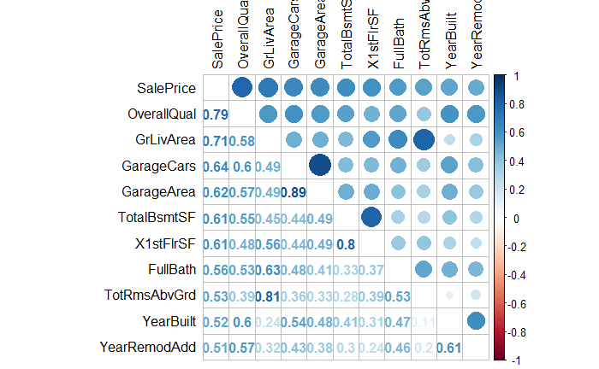
Correlation with Sale Price
There are 10 numeric variables with at least a 0.5 correlation with Sale Price. All correlations are positive. Through this plot, it becomes clear that multicollinearity is an issue. Brief EDA of top 3 correlations with Sales Price follows.

Slide 9
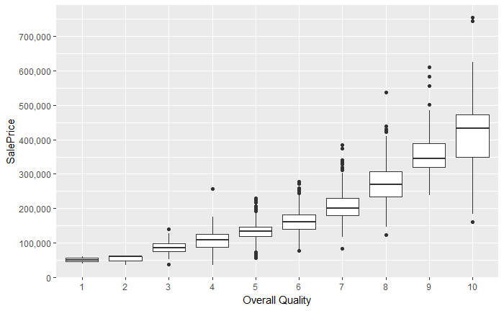
OverallQual correlation with SalePrice
Overall Quality had the highest correlation, 0.79, with SalePrice among numeric variables. SalePrice rises as OverallQual improved.

Slide 10
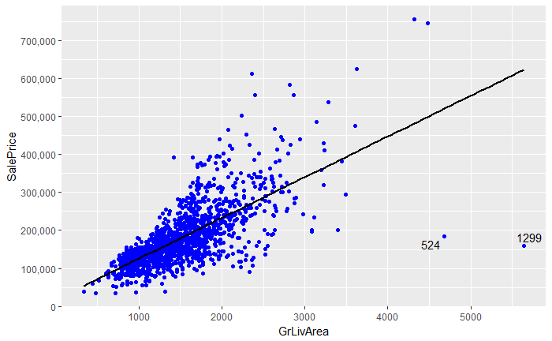
GrLivArea correlation with SalePrice
Overall Quality had the 2nd highest correlation, 0.71, with SalePrice among numeric variables. Generally, SalePrice is higher as GrLivArea increases. Outlier exceptions for house #524 and #1299

Slide 11
Data Wrangling
Missing Data, Label Encoding & Factorizing Variables

Slide 12
Tidy Data Summary
Identifying Missing Data
Factorizing certain Numeric
Label encoding/factoring character variables
VariablesOf the original set, 34 variables contain are missing values.
After data imputing, there are 15 variables that remain with character values and need label encoding/factorization.
After imputation and factorization, ‘YrSold’, ‘MoSold’ and ‘MSSubClass’ remain to be converted to a categorical variable.

Slide 13
EDA of Important Variables

Slide 14
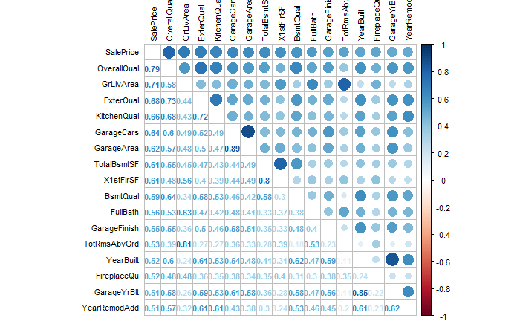
Correlations with SalePrice
After a detailed data wrangling process, 56 variables are numeric, 23 are categorical, and 1 (Utilities) was deleted due to irrelevance.
The number of variables with a correlation of at least 0.5 with SalePrice increased from 10 (pre-cleaning) to 16 (post cleaning).

Slide 15
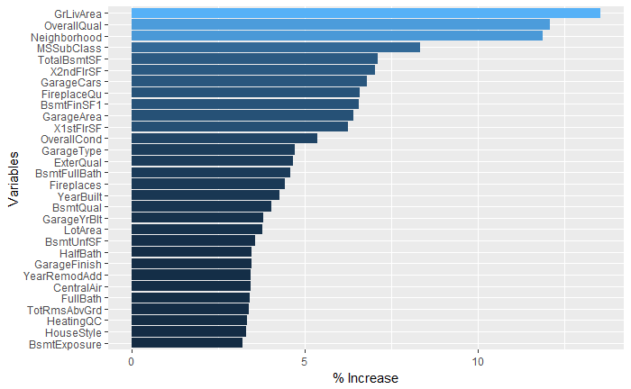
Importance of Variables using RandomForest
In addition to the overview which correlation give the importance of numeric variables and their multicollinearity.
This quick RandomForest includes the importance of both numeric and categorical.

Slide 16
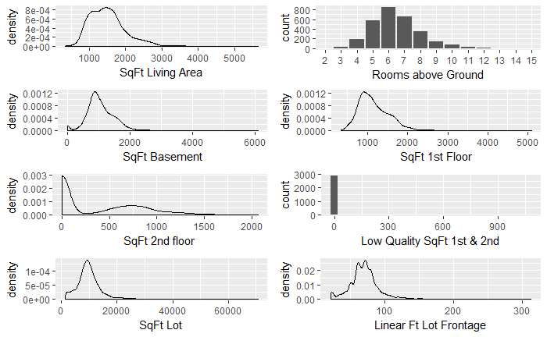
EDA of GrLivArea and other “SqFt” Variables
Visualizing the distribution of GrLivArea and other importance “SqFt” variables.

Slide 17
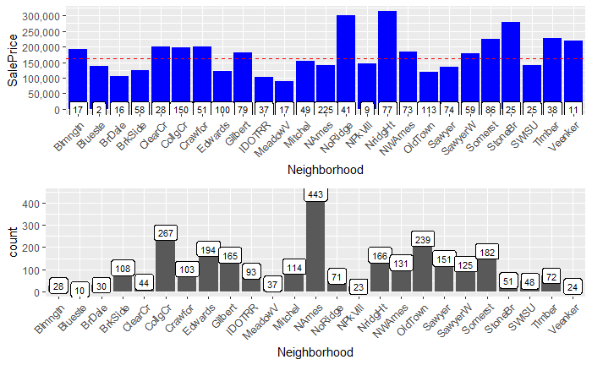
EDA of Neighborhood with SalePrice and House Count
According up the above quick RandomForest, Neighborhood is the most important categorical variable.

Slide 18
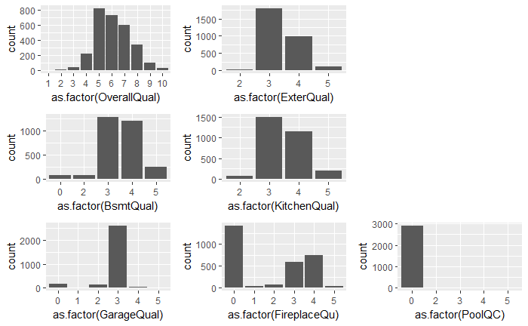
EDA of OverallQual and other Quality Variables
Frequency distribution of quality variables.

Slide 19
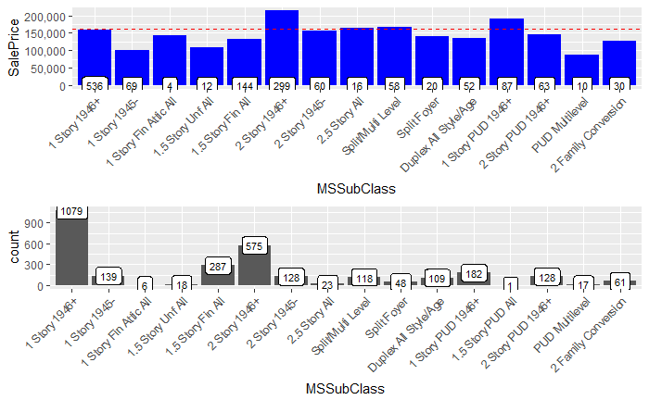
EDA of MSSubClass with SalePrice and House Count
Frequency distribution of 2nd most important categorical variable.

Slide 20
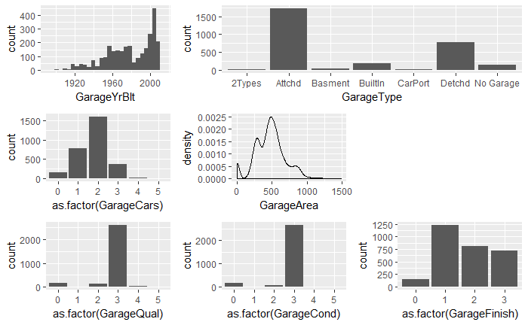
EDA of Garage Variables
7 variables have a high correlation with SalePrice, but multicollinearity exists among them.

Slide 21
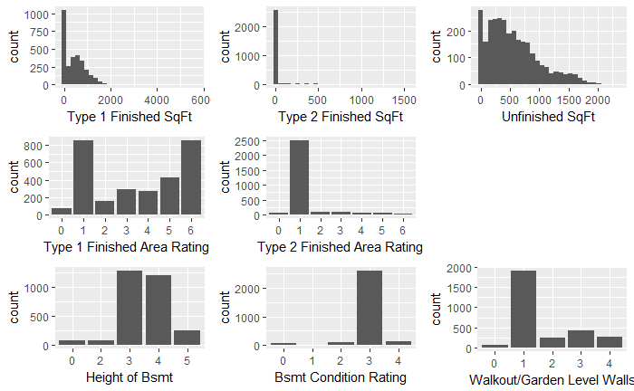
EDA of Basement Variables
11 variables have a high correlation with SalePrice, but multicollinearity exists among them.
TotalBsmtSF is further broken down into finished areas (2 if more than one type of finish), and unfinished area. Correlation of total of those 3 variables, and TotalBsmtSF is 1.

Slide 22
Feature Engineering

Slide 23
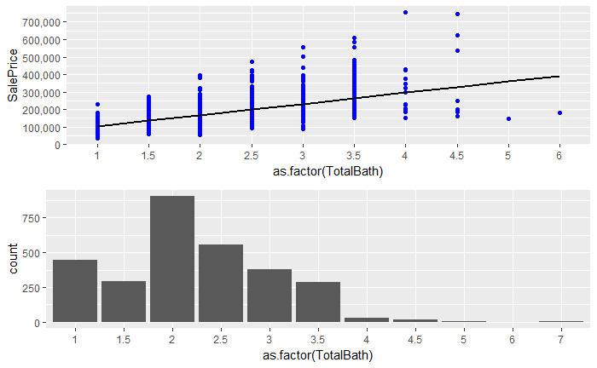
Adding ‘TotalBath’ with EDA
Combining 4 bathroom variables into 1. Quick EDA of TotalBath with SalePrice and Count

Slide 24
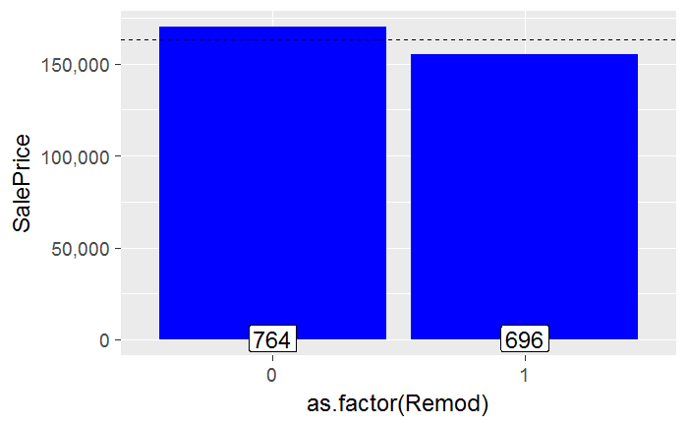
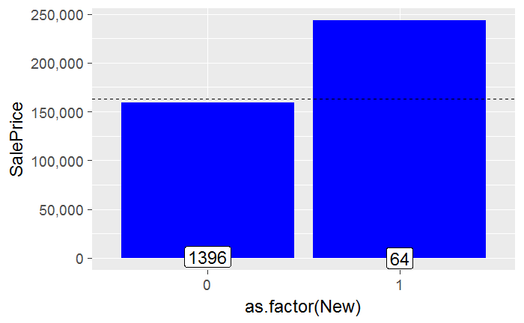
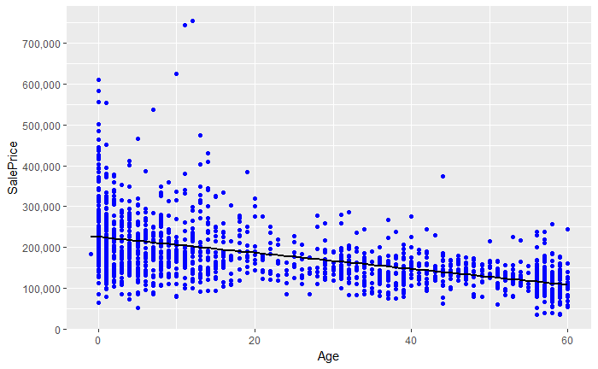
Adding ‘Age’, ‘Remod’, and ‘New’ with EDA
There are 3 variables that are relevant in regards to a house, the YearBlt, YearRemod and YearSold. If a house was remodeling, YearRemod is that year or defaults to YearBlt is no remodeling took place. It is useful to differentiate between the Age of the house, if it was modeled, and if it is a new build.

Slide 25
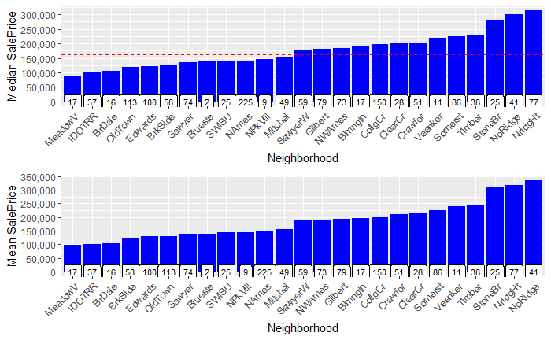
Binning Neighborhoods
Both median and mean SalePrice agree on the 3 “rich neighborhoods,” but are harder to differentiate in “poor neighborhoods”.
3 categories determining neighborhood “wealth” will be created.

Slide 26
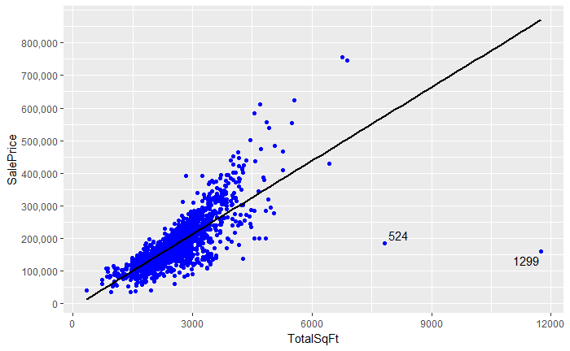
Adding ‘TotalSqFt’ with EDA
There are 2 variables detailing total SqFt, adding both together allows for a more complete picture of the house.
Removing the two outliers, #524 and #1299, allows for SalePrice and TotalSqFt correlation to up by 5%.

Slide 27
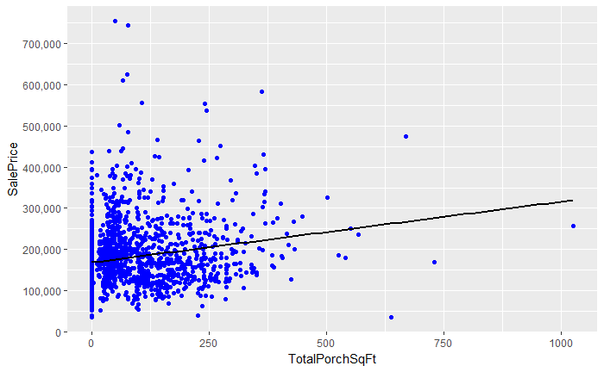
Adding ‘TotalPorchSqFt’ with EDA
There are 5 different variables that detail an aspect of a porch.
Despite having a low correlation with SalePrice, it doesn’t hurt to combine all 5 into one variable.

Slide 28
Model Prep

Slide 29
Prepping Overview
Removing Highly Correlated Variables
Of variables pairs that are highly correlated, dropping variable with least correlation with SalePrice.
Removing Outliers
As seen above in various EDAs, homes #524 an #1299 are outliners. Once removed, they increase correlation.
Prepping Predictor Variables
Splitting categoric and numeric predictor variables. Of this, there are 30 numeric and 49 categoric variables.
Absolute Skewness and Normalization of Numeric Variables
Log of all numeric predictor variables with an absolute skew grater than 0.8 to avoid division by 0.
Hot Encoding Categorical Variables
Converting all factor variables to binary (Yes/No, 1s and 0s) to prep for ML models.
Removing records with few/none values in train or test sets
In total 49 hot-encoded predictor variables were removed due to little or no variance.

Slide 30
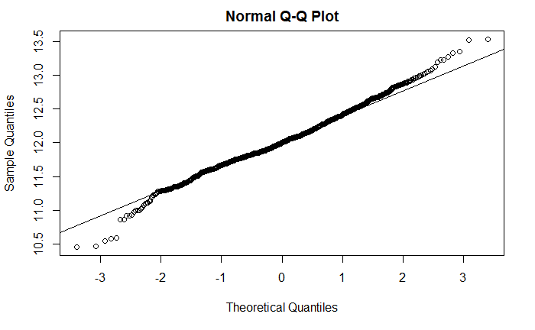
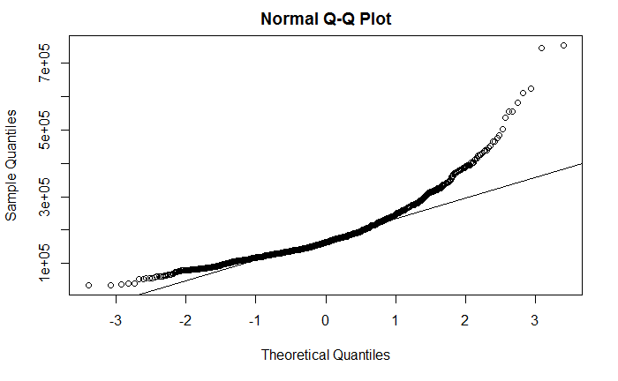
Skewness of Response Variable
Normalization of SalePrice necessary as 1st EDA details that its log (2nd EDA) is needed to normally distribute.

Slide 31
Modeling

Slide 32
Lasso Regression Model
Caret Cross Validation is used to find the best value of lamda, the only hyperparameter tuning in Lasso. This model dealt with multicollinearity of variables very well by not using roughly 46% of the predictor variables. Lasso Regression performed with a cross validation RMSE of 0.1142

Slide 33
XGBoost Model
This model provides a cross validation function to determine the optimal number of rounds and supplemented with a grid search for hyperparameters. XGB performed with a cross validation RMSE of 0.1189.

Slide 34
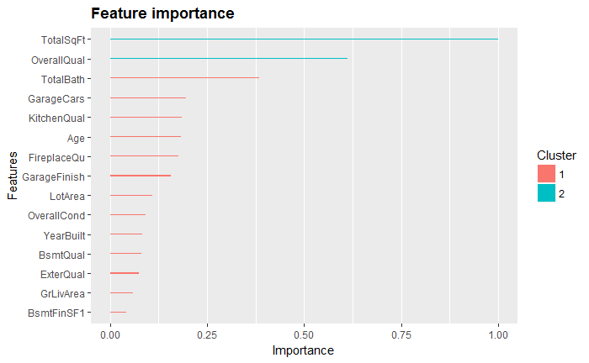
Feature Importance
Using a kmeans package for ggplot clustering, Ckmeans.1d.dp, Feature Importance was determined according to XGBoost.
This EDA is similar to the original quick RandomForest and Collinearity Plots EDAs.
Clustering is essentially identifying most important variables and those that are supplemental for predicting SalePrice.

Slide 35
Averaging Lasso & XGBoost Model Predictions
Although Lasso and XGBoost are fundamentally different models, averaging of the predictions performed to improve the test set results.

